Slide 1


Accelerated Reader
Introductory guide

Slide 2

The Importance of Reading
Evidence suggests that children who read for enjoyment every day not only perform better in reading tests than those who don’t, but also develop a broader vocabulary, increased general knowledge and a better understanding of other cultures.
In fact, reading for pleasure is more likely to determine whether a child does well at school than their social or economic background.

Slide 3
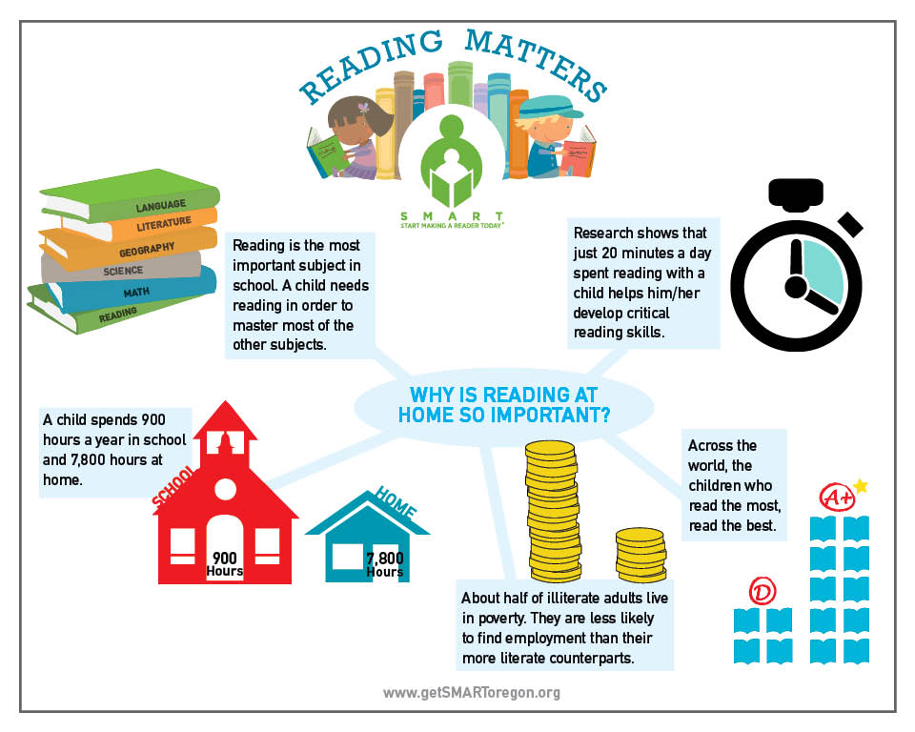
The Importance of Reading

Slide 4
Accelerated Reader
Accelerated Reader is a program designed to do the following things:
1) Find books that are the right ability for the child
2) Encourage the child to read more
3) Improve the child’s reading ability

Slide 5
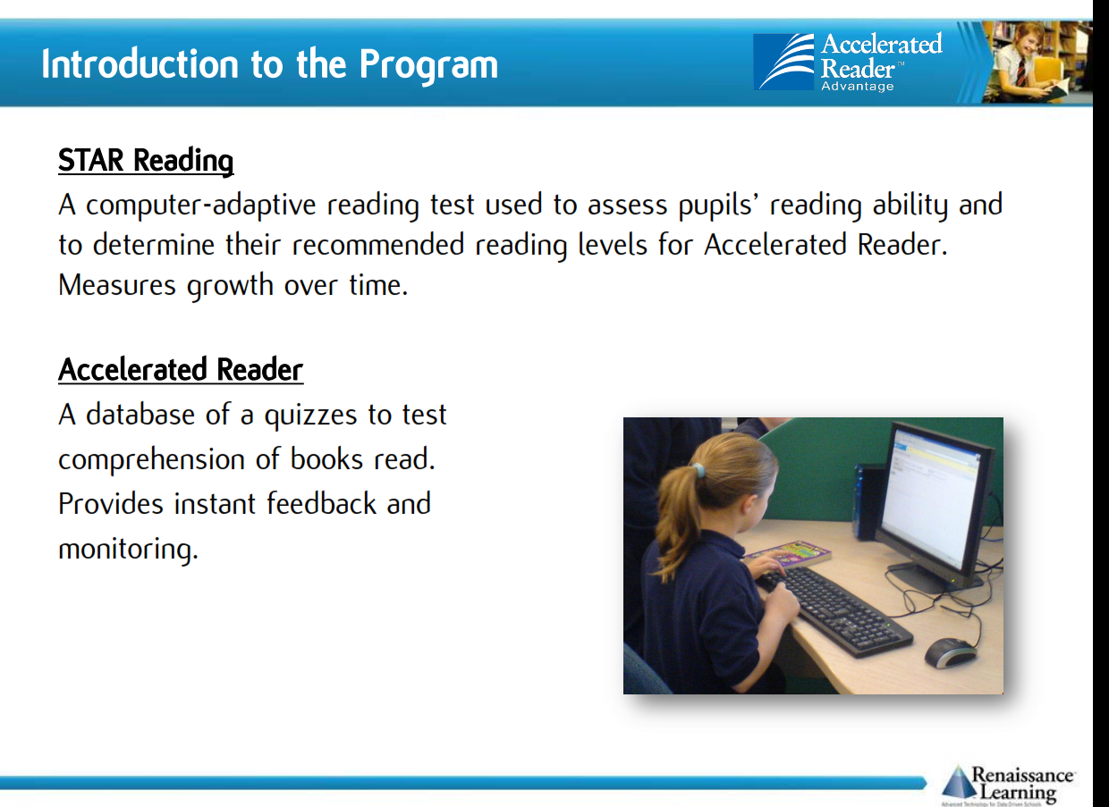

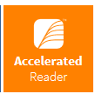
Two parts to the program
To be completed in school ONLY
To be completed in school AND at home
Notes:
https://ukhosted62.renlearn.co.uk/1892677/default.aspx If they can’t find it

Slide 6
Star Reading
Completed every term in school.
At the start of each term, pupils will complete a Star Reading Test, which is a computer-based test that measures a student’s reading ability through a series of 34 questions.
Every test for every student is different, and the computer selects different questions for each student dependent on how well they answer the previous questions. Essentially, the computer adapts the test to suit the child.
Test results will be made available to parents on a termly basis.
Notes:
https://ukhosted62.renlearn.co.uk/1892677/default.aspx If they can’t find it

Slide 7
ZPD score
(Zone of Proximal Development)
After each Star Reading test, children are given a ZPD range, which is two numbers that the pupil uses to choose their next reading book.
The lowest number is the lowest level of book the pupil should be choosing.
The highest number is the highest level of book the pupil should be choosing.
Pupils keep a record of all their ZPDs in their planners.
A new STAR test takes place every half term, so students can see improvements in their reading ability, but also choose more challenging books.
3.2 – 4.6
Lowest number
Highest number

Slide 8
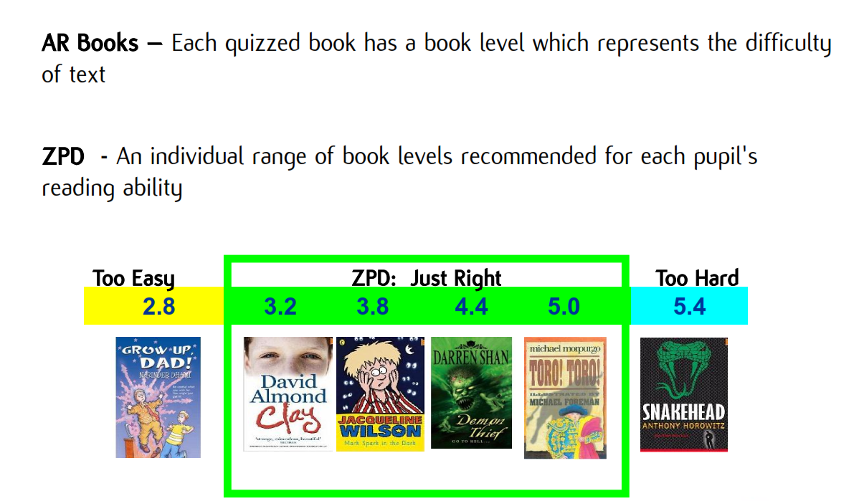
Accelerated Reader books

Slide 9
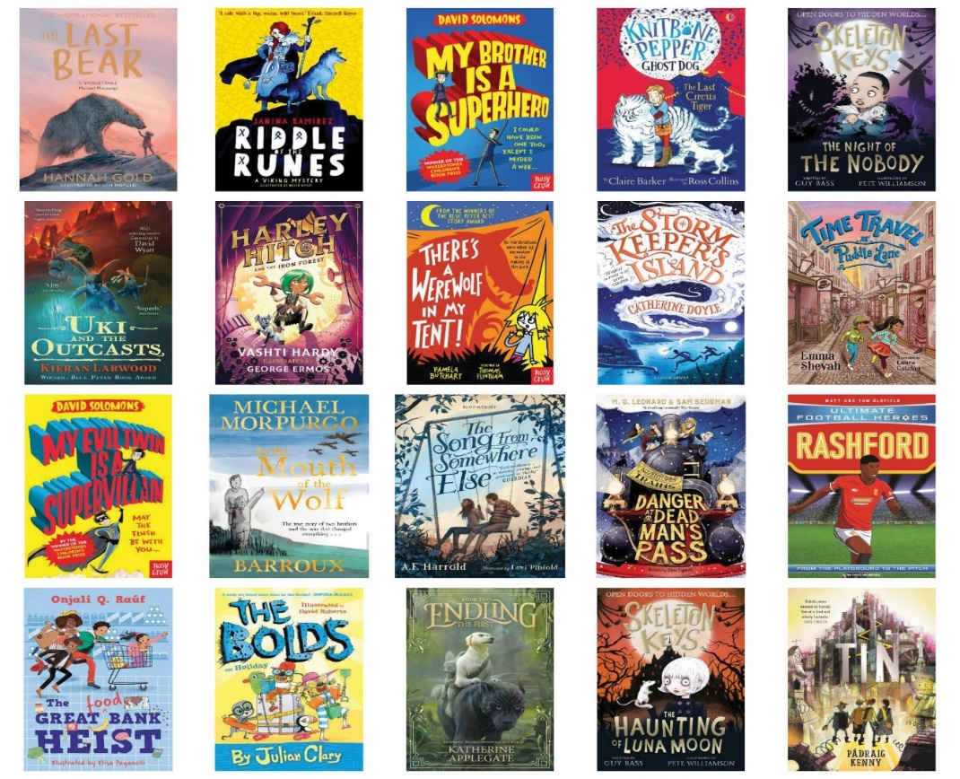
Accelerated Reader books
The school has spent a great deal of money on new reading books for children from year 5 to 8. This comprises of brand new books for fiction and non-fiction texts and Mrs Molyneux, our dedicated school librarian, is constantly updating and refreshing the stock.

Slide 10
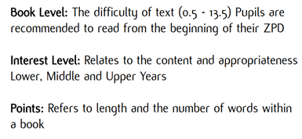
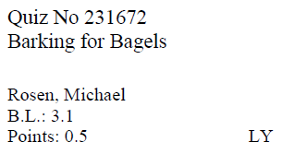
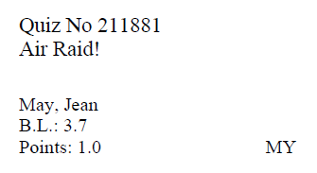
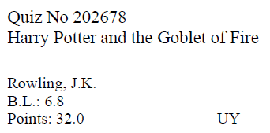



Accelerated Reader books

Slide 11
Accelerated Reader at Arnold Academy
AR will be used to monitor reading and progress over time and should benchmarks highlight the need for intervention, we will act on this with the urgency required.
Books will be issued and returned during library/English lessons, or during lunch time library club.

Slide 12
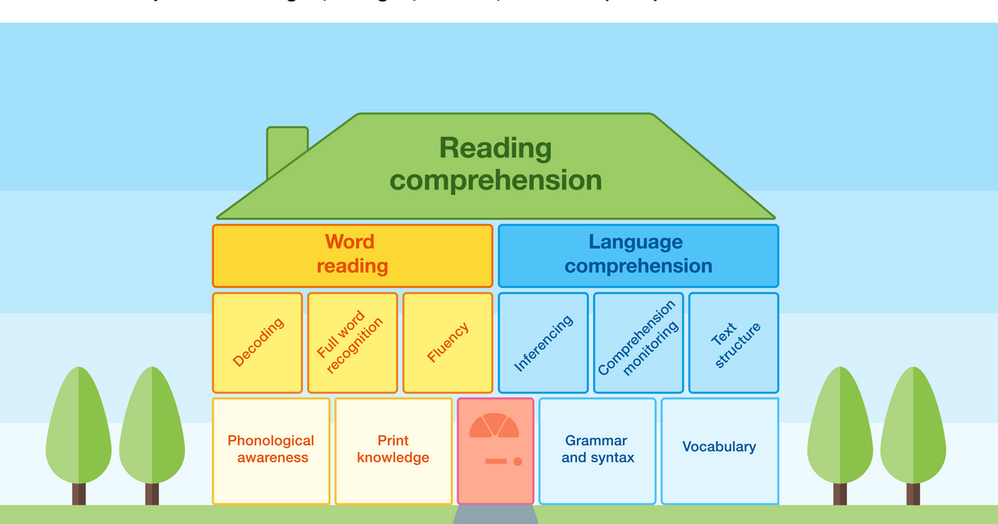
What can be done?
The EEF have recently published their ‘Reading Comprehension House’ blog which states the following:
‘The complexity of the teaching of reading can feel overwhelming. However, useful models such as the ​‘Reading Comprehension House’ can help us better understand why. Adapted from Hogan, Bridges, Justice and Cain’s 2011 publication, the reading house creates clarity to support our understanding of the different aspects we need to consider in our teaching.’

Slide 13
Accelerated Reader quizzes
A quiz is taken after a book has been read.
There are usually about 10 multiple choice questions on the book. At the end of the quiz, the pupils are given a percentage to show them how well they have done. Generally they need a pass rate of 60% or higher to earn the points.
Points are based on pro rata basis depending on how well they do on their reading comprehension quiz.
Some vocabulary practice quizzes can be taken as well, but we recommend focusing on ‘Reading Practise’ quizzes at home. Article Quizzes will be used at the direction of staff in school.
There are some important rules for taking quizzes:
1) The quiz should take place within 24 hours of finishing the book if possible.
2) A student cannot take a quiz until they have read the entire text.
3) Quizzes must be done individually, not with anyone’s help.

Slide 14
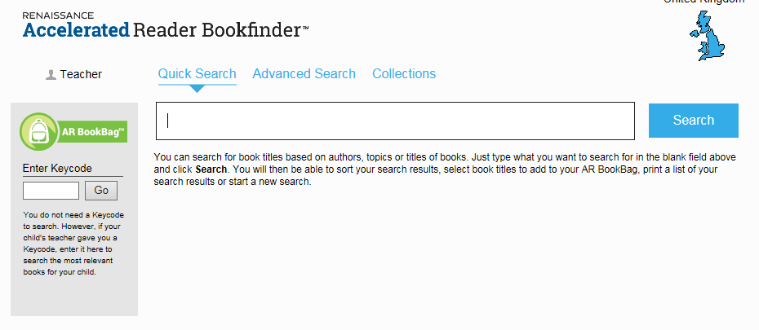
How do you know a book’s values?
You can find all the information you need using the online AR Bookfinder tool.
https://www.arbookfind.co.uk/UserType.aspx?RedirectURL=%2fdefault.aspx
Quizzes can be taken on any book found here even if they are not from the school library.

Slide 15

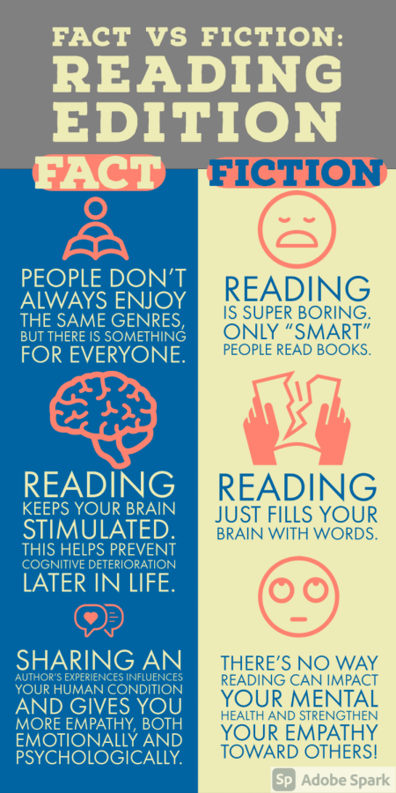
The Benefits of Reading

Slide 16
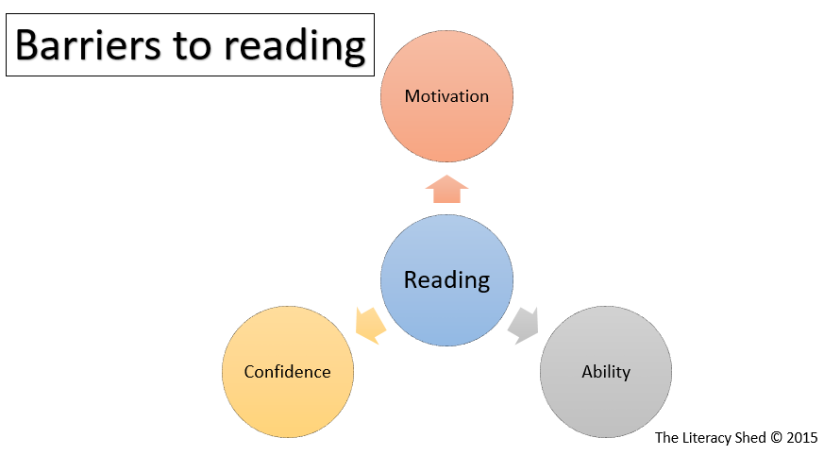

Ultimate goal is to remove …

Slide 17
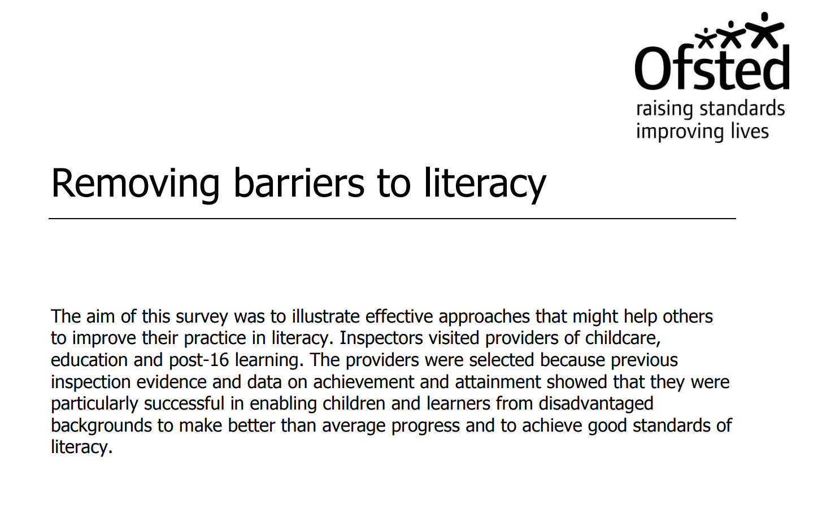
Further Reading
Click on the image below to be redirected to additional material around the topic of reading.

Slide 18


Further Reading
Click on the images below to be redirected to additional material around the topic of reading.

